Slide 1
4.0 Two Port Theory
EE1203 – Theory of Electricity
Prof J. Rohan Lucas
lucas@kdu.ac.lk
Department of Electrical, Electronic & Telecommunication Engineering
General Sir John Kotelawala Defence University
September 2020

Slide 2
Learning Outcomes
On completion of module, student will be able to
LO1: Analyse the performances of AC circuits
Analyse circuits using nodal and mesh theory
LO2: Analyse two port networks using different models.
LO3: Analyse transfer functions of RLC networks for transients.
LO4: Analyse waveforms for its harmonics.
LO5: Perform calculations in three phase circuits including unbalanced waveforms.
t
Notes:
.

Slide 3
Port
Pair of nodes across which a device can be connected. Voltage is measured across pair of nodes.
Current going into one node is the same as the current coming out of the other node in the pair.
These pairs are entry (or exit) points of the network. Compare with an Airport or a Sea Port.
Landing
Take-off
Entry and exit points to a country.
Planes that enter at a given port are the ones that take off from same port.

Slide 4
Systematic treatment of networks
Convenient to develop special methods.
Single-port linear active networks
  Thevenin’s or Norton’s equivalent circuit.
  Linear passive networks
  Study relative to a pair of designated ports.
I₁
I₂
Linear
Passive
Network
V₁
Port 1
Port 2
V₂

Slide 5
Definitions
Driving point impedance is defined as ratio of applied voltage (driving point voltage) across a node-pair to the current entering at the same port.
[input impedance of network seen from particular port]
Driving point impedance at Port 1 = V₁/I₁
Driving point impedance at Port 2 = V₂/I₂
Driving point admittance is similarly defined as the ratio of the current entering at a port to the applied voltage across the same node-pair.
Driving point admittance at Port 1 = I₁/V₁
Driving point admittance at Port 2 = I₂/V₂

Slide 6
Immittance is sometimes used to represent either an impedance or an admittance
Transfer impedance is defined as the ratio of the applied voltage across a node-pair to the current entering at the other port.
Transfer impedance = V₁/I₂ , V₂/I₁
Transfer admittance is defined as the ratio of the current entering at a port to the voltage appearing across the other node-pair.
Transfer admittance = I₁/V₂ , I₂/V₁

Slide 7
Transfer Voltage gain (or ratio) is defined as the ratio of the voltage at a node pair to the voltage appearing at the other node-pair.
Transfer voltage gain = V₁/V₂ , V₂/V₁
Transfer Current gain (or ratio) is similarly defined as the ratio of the current at a port to the current at the other port.
Transfer current gain = I₁/I₂ , I₂/I₁

Slide 8
Common Two-port parameters
External conditions of a two-port network can be completely defined by currents and voltages at the 2 ports.
A general two port network can be characterised by four parameters, derived from the network elements.
With symmetry, number of parameters will be reduced.
(a) Impedance parameters
(b) Admittance parameters
(c) Transmission Line parameters
(d) Hybrid parameters.

Slide 9
(a) Impedance Parameters (z-parameters) or Open-circuit parameters
I₁
I₂
Linear
Passive
Network
V₁
Port 1
Port 2
V₂
V₁ = z₁₁ I₁ + z₁₂ I₂
If I₂ = 0, then z₁₁ = V₁/I₁
If I₁ = 0, then z₁₂ = V₁/I₂

Slide 10
It follows that,
,
,
,
z-parameters correspond to the driving point and transfer impedances at each port with the other port having zero current (i.e. open circuit).
→ open circuit parameters.

Slide 11
Example 3
Find impedance parameters of the two port T – network.
With port 2 on open circuit
I₁
Z_{a}
Z_{c}
I₂
V₁
Port 1
Z_{b}
Port 2
V₂
similarly with port 1 open,
z₁₂ = Z_{b}
z₂₂ = Z_{b} + Z_{c}

Slide 12
(b) Admittance Parameters (y-parameters) or Short-circuit parameters
I₁
I₂
Linear
Passive
Network
V₁
Port 1
Port 2
V₂
y₁₁, y₁₂, y₂₁, y₂₂ defined with either V₁ or V₂ zero.
y-parameters correspond to driving point and transfer admittances at each port with the other port having zero voltage (i.e. short circuit) → short circuit parameters.

Slide 13
Example 4
Find admittance parameters of the 2 port π–network.
I₁
Y_{b}
I₂
I₁
Y_{b}
I₂
V₁
V₁
Y_{a}
Y_{c}
V₂
Y_{a}
Y_{c}
V₂=0
with port 2 on short circuit
y₁₁ =
= Y_{a} + Y_{b}
→[Y] =
y₂₁ =
= – Y_{b}

Slide 14
(c) Transmission Line Parameters (ABCD-parameters)
I₁
I₂
Linear
Passive
Network
V₁
Port 1
Port 2
V₂
Parameters can be defined using either port 2 on short circuit or port 2 on open circuit.
In case of symmetrical system, parameter A = D.
For a reciprocal system, A.D – B.C = 1

Slide 15
Example 5
I₁
Y_{c}
I₂
Find ABCD parameters.
A =
, B =
V₁
Y_{a}
Y_{b}
V₂
C =
and D =
[For symmetrical network, Y_{a} = Y_{b} , A = D].
A.D – B.C =
=
=1

Slide 16
(d) Hybrid Parameters (h-parameters)
I₁
I₂
Linear
Passive
Network
V₁
Port 1
Port 2
V₂
The hybrid parameter matrix may be written as
h-parameters can be defined as in other examples, and are commonly used in some electronic circuit analysis.

Slide 17
Interconnection of two-port networks
(a) Series connection of two-port networks
Series properties are applied to each port
at port 1, I_{r1} = I_{s1} = I₁, and V_{r1} + V_{s1} = V₁
at port 2 I _{r2} = I_{s2} = I₂, and V_{r2} + V_{s2} = V₂
[Z] = [Z_{r}] + [Z_{s}]
I_{r1}
I_{r2}
Linear
Passive
Network
r
V_{r1}
Port r₁
Port r₂
V_{r2}
V₁
V₂
I_{s1}
I_{s2}
Linear
Passive
Network
s
V_{s1}
Port s₁
Port s₂
V_{s2}

Slide 18
(b) Parallel connection of two-port networks
I₁
I_{r1}
I_{r2}
I₂
Linear
Passive
Network
r
V_{r2}
V₂
V₁
V_{r1}
I_{s1}
I_{s2}
Linear
Passive
Network
s
V_{s2}
V_{s1}
at port 1, I_{r1} + I_{s1} = I₁, and V_{r1} = V_{s1} = V₁
at port 2, I _{r2} + I_{s2} = I₂, and V_{r2} = V_{s2} = V₂
[Y] = [Y_{r}] + [Y_{s}]

Slide 19

(c) Cascade connection of networks
Output of one network becomes input to next.
I_{r2} = I_{s1} V_{r2} = V_{s1}
,
I_{r1}
I_{r2}
I_{s1}
I_{s2}
Linear
Passive
Network
Linear
Passive
Network
V_{r1}
Port r1
Port r2
V_{r2}
V_{s1}
Port s1
Port s2
V_{s2}

Slide 20
ABCD matrix of component networks
I₁
I₂
I₁
I₂
Z
V₁
V₂
V₁
V₂
Y
A =
= 1, = 1
B =
= Z, = 0
C =
= 0, =Y
D =
= 1, = 1

Slide 21
In matrix form
=
, =
I₁
Y_{b}
I₂
Y_{b}
V₁
≡
Y_{a}
Y_{c}
V₂
Y_{a}
Y_{c}
Consider example 5 again
=
Simplification of matrix product would give the same answer as in example 5.

Slide 22
Input Impedance of Two-Port Network Z_{Input}
I₂
I₁
Z_{Input}
Two-Port
Network
V₁
V₂
Port 1
Port 2
Z_{Load}
Z_{Input} depends on Input Port and on Load Z_{Load}
Example:
With Load = 4Z at Port 2
Z_{Input, Port 1} = Z + 4Z//4Z = 3Z
With Load = 4Z at Port 1
Z_{Input, Port 2} = 4Z//(Z+4Z) = 2.222 Z
With Load = 6Z
Z_{Input, Port 1} = 3.4 Z, Z_{Input, Port 2} = 2.545 Z
Z
Port 1
4Z
Port 2

Slide 23
Image Impedance
I₁
I₂
I₁
I₂
Two-Port
Network
Two-Port
Network
Z_{I1}
V₁
V₂
Z_{I2}
Z_{I1}
V₁
V₂
Z_{I2}
Port 1
Port 2
Port 1
Port 2
Pair of Image impedances unique to Network
When load = Z_{I2} at Port 2
→ Input = Z_{I1} at Port 1
Then with load = Z_{I1} at Port 1
→ Input = Z_{I2} at Port 2
Best analysed by considering two such circuits in reverse cascade connection to reduce variables

Slide 24
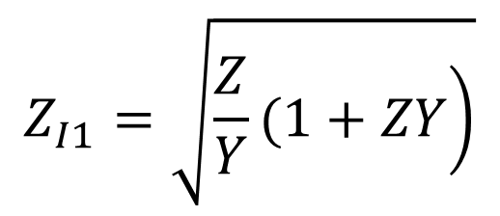
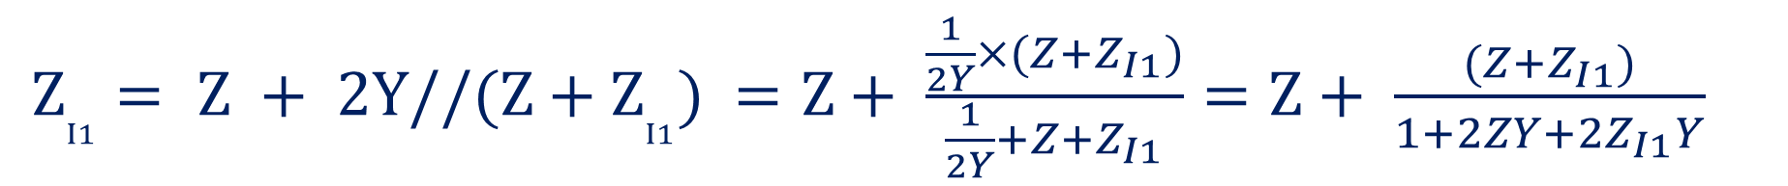
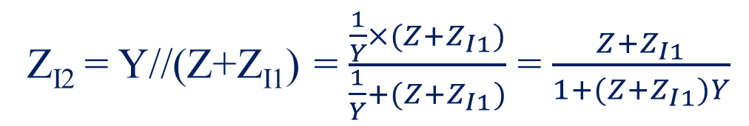
Example
Z
Z
Z
Z
Z
Z_{I1}
Z_{I2}
⇒
Z_{I1}
Z_{I2}
⇒
Y
Z_{I1}
Z_{I1}
Z_{I1}
→
→
→
Y
→
Y
2Y
→
Reverse back-to-back networks are connected in cascade.
$Z_{I1}= Z + 2Y//(Z+Z_{I1})$ $=Z+ \frac{\frac{1}{2Y}×(Z+Z_{I1})}{\frac{1}{2Y}+Z+Z_{I1}}=Z+ \frac{(Z+Z_{I1})}{1+2ZY+{2Z}_{I1}Y}$
i.e. Z_{I1}+ 2 Z_{I1}ZY + 2 Z_{I1}² Y = Z+ 2 Z²Y + 2 Z_{I1} ZY + Z + Z_{I1}
$$Z_{I1}=\sqrt{\left.\frac{Z}{Y}(1+ZY\right)}$$
gives 2Y Z_{I1}² = 2Z (1+ZY) →
Z_{I2} = Y//(Z+Z_{I1}) = $\frac{\frac{1}{Y}×(Z+Z_{I1})}{\frac{1}{Y}+(Z+Z_{I1})}$ = $\frac{Z+Z_{I1}}{1+(Z+Z_{I1})Y}$
(substitute for Z_{I1} and solve)

Slide 25
Characteristic Impedance Z₀
I₁
I₂
Z₀
Two-Port
Network
V₁
V₂
Port 1
Port 2
Z₀
When 2-port network is symmetric, the image impedances become equal and is defined as Characteristic Impedance
Evaluated using ABCD or other 2 port parameters.
At Port 1, V₁ = Z₀ I₁
At Port 2, V₂ = Z₀ I₂
Matrix equation can be expanded as
V₁ = A V₂ + B I₂ = A Z₀ I₂ + B I₂ = (A Z₀ + B) I₂
I₁ = C V₂ + D I₂ = C Z₀ I₂ + D I₂ = (C Z₀ + D) I₂
∴ V₁ = Z₀ I₁ → (A Z₀ + B) I₂ = Z₀ (C Z₀ + D) I₂

Slide 26
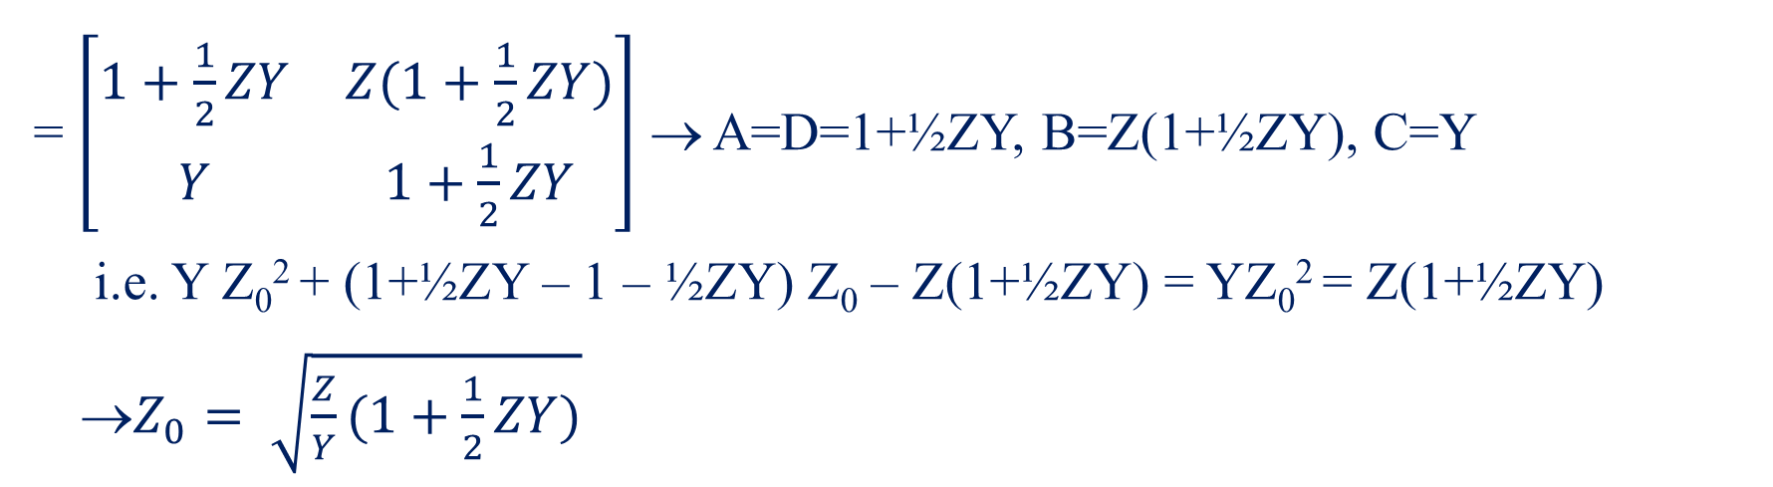
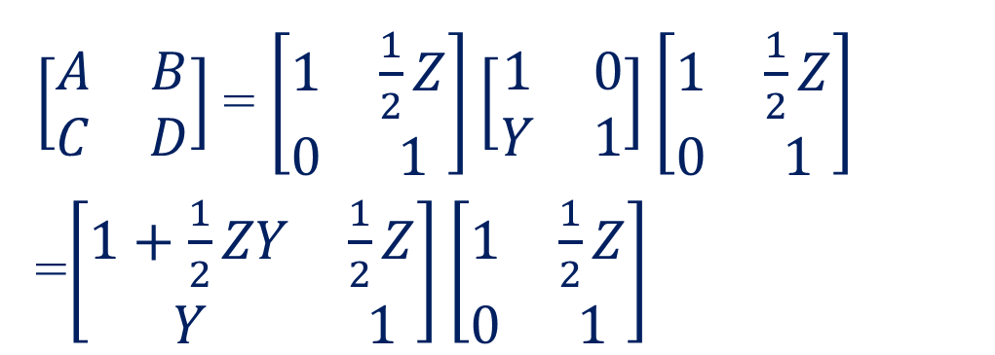
∴ A Z₀ + B = Z₀ (C Z₀ + D)
→ C Z₀² + D Z₀ = A Z₀ + B, i.e. C Z₀² + (D – A) Z₀ – B = 0
For symmetrical network, A=D → Z₀= √B/C
½ Z
½ Z
$\left[\begin{matrix}A & B \\ C & D\end{matrix}\right]$= $\left[\begin{matrix}1 & \frac{1}{2}Z \\ 0 & 1\end{matrix}\right]\left[\begin{matrix}1 & 0 \\ Y & 1\end{matrix}\right]\left[\begin{matrix}1 & \frac{1}{2}Z \\ 0 & 1\end{matrix}\right]$
=$\left[\begin{matrix}1+\frac{1}{2}ZY & \frac{1}{2}Z \\ Y & 1\end{matrix}\right]\left[\begin{matrix}1 & \frac{1}{2}Z \\ 0 & 1\end{matrix}\right]$
Example:
Port 1
Y
Port 2
= $\left[\begin{matrix}1+\frac{1}{2}ZY & Z(1+\frac{1}{2}ZY) \\ Y & 1+\frac{1}{2}ZY\end{matrix}\right]$ → A=D=1+½ZY, B=Z(1+½ZY), C=Y
i.e. Y Z₀² + (1+½ZY – 1 – ½ZY) Z₀ – Z(1+½ZY) = YZ₀² = Z(1+½ZY)
→$Z_{0}= \sqrt{\frac{Z}{Y}(1+\frac{1}{2}ZY)}$

Slide 27
End of Presentation

